Slide 1

THE SPARKS FOUNDATION INTERNSHIP WEB DEVELOPMENT TASK PAYMENT GATEWAY INTEGRATION
By mandar Phirke
72025840F

Slide 2

Internship Organization
The Sparks Foundation Globalare a team with an aim to provide students with a platform to research and make projects in the field of AI and ML, Web Development and Data Science. They aim to provide an interactive learning platform for students where they will be able to learn and develop projects with their support.

Slide 3

DETAILS OF INTERNSHIP
Duration - 2Months
Offer Letter Certificate
Starting Date : 01/11/2021
Completion Date :
02/12/2021
Completion Letter Certificate

Slide 4
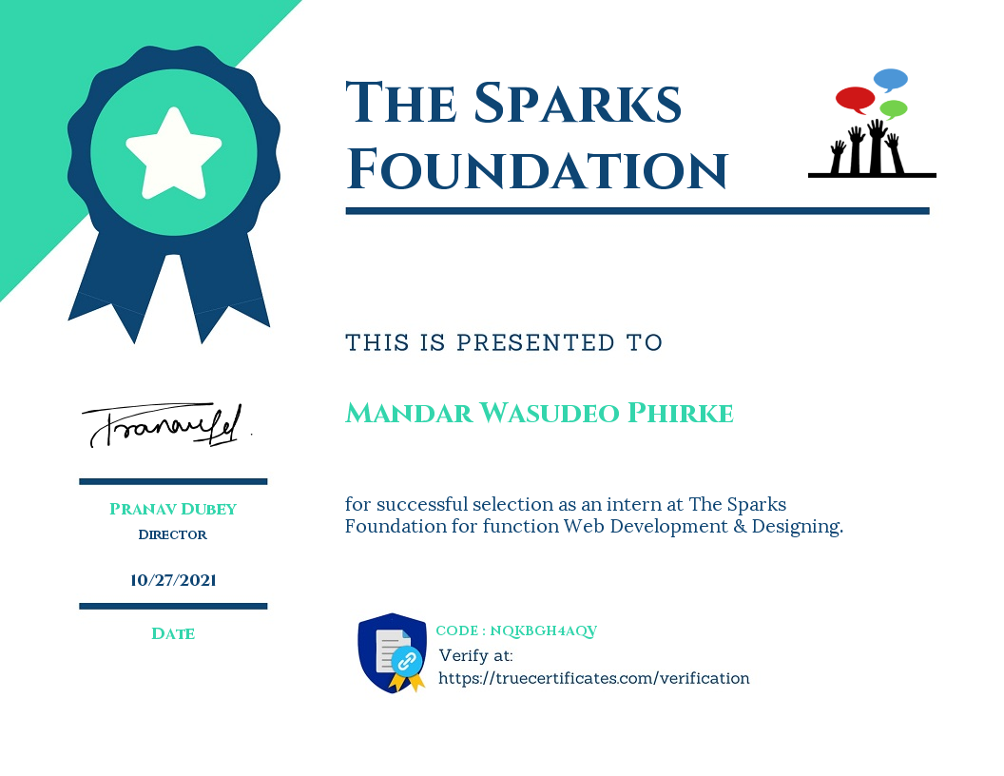
OFFER LETTER

Slide 5
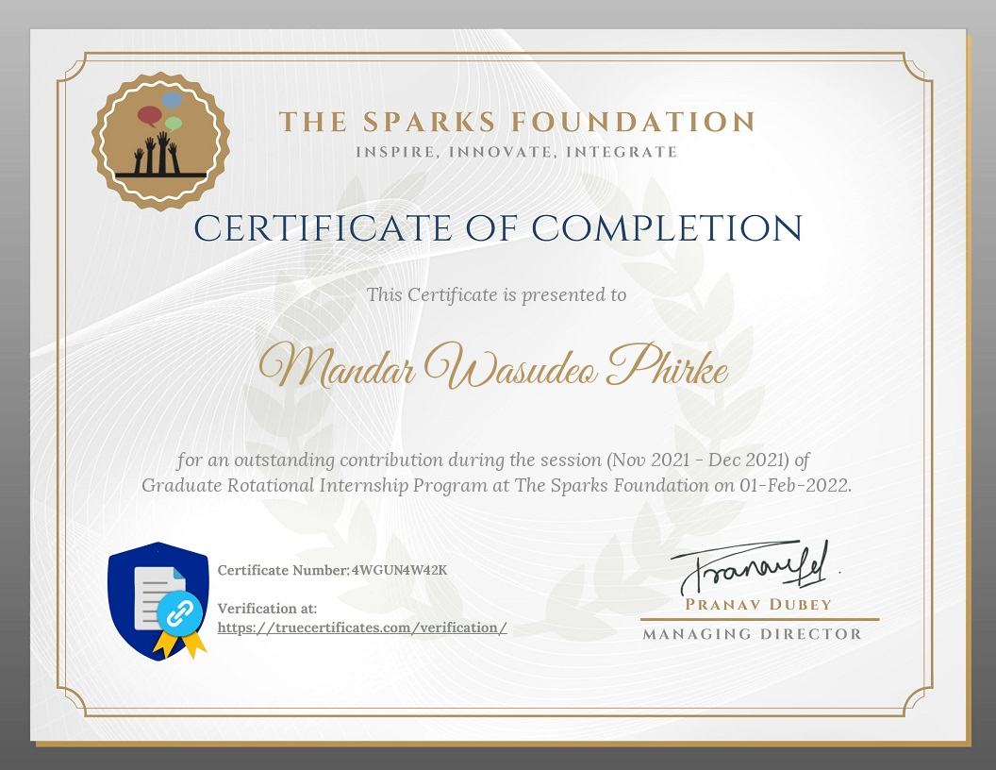
CERTIFICATE OF COMPLETION :

Slide 6
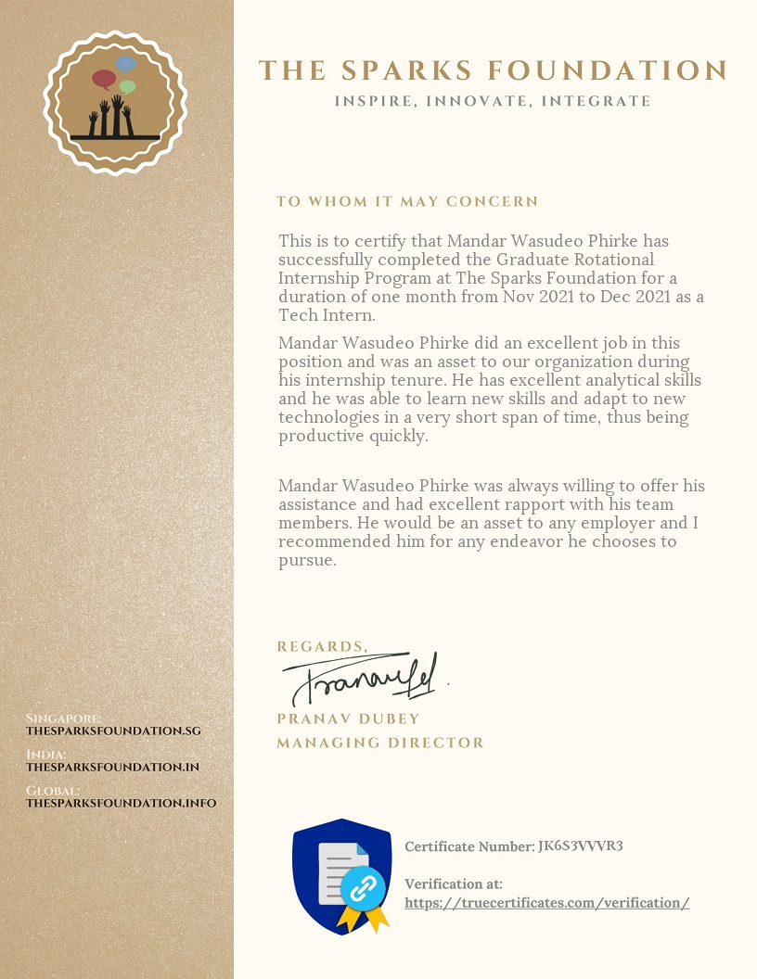
LETTER OF RECOMMENDATION

Slide 7
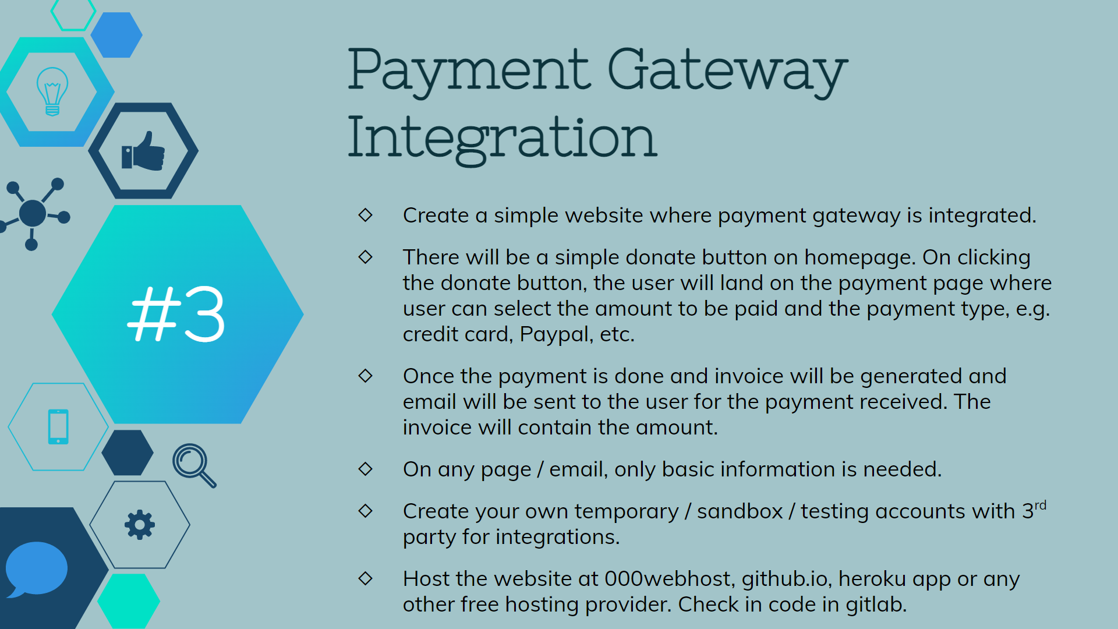

Slide 8
Objectives:
To create a website with the help of HTML, CSS and Razorpay gateway to make payment gateway system.
To donate the money to necessary ones.

Slide 9
Github Links:
In this project. I created a static website using simple HTML, CSS and deploy razorpay payment gateway. I have completed this project within 1 week of time period. By completing this project, I was able to learn the basic of HTML, CSSand learn about software development and vision control.
Github repository link: https://github.com/mandarphirke/sparksinternship.github.io
Deployment link: https://mandarphirke.github.io/sparksinternship.github.io
LinkedIn video link: https://www.linkedin.com/posts/mandarphirke_task3-gripnov21-gripnovember21-activity-6867368088606785536-cftF?utm_source=linkedin_share&utm_medium=android_app

Slide 10
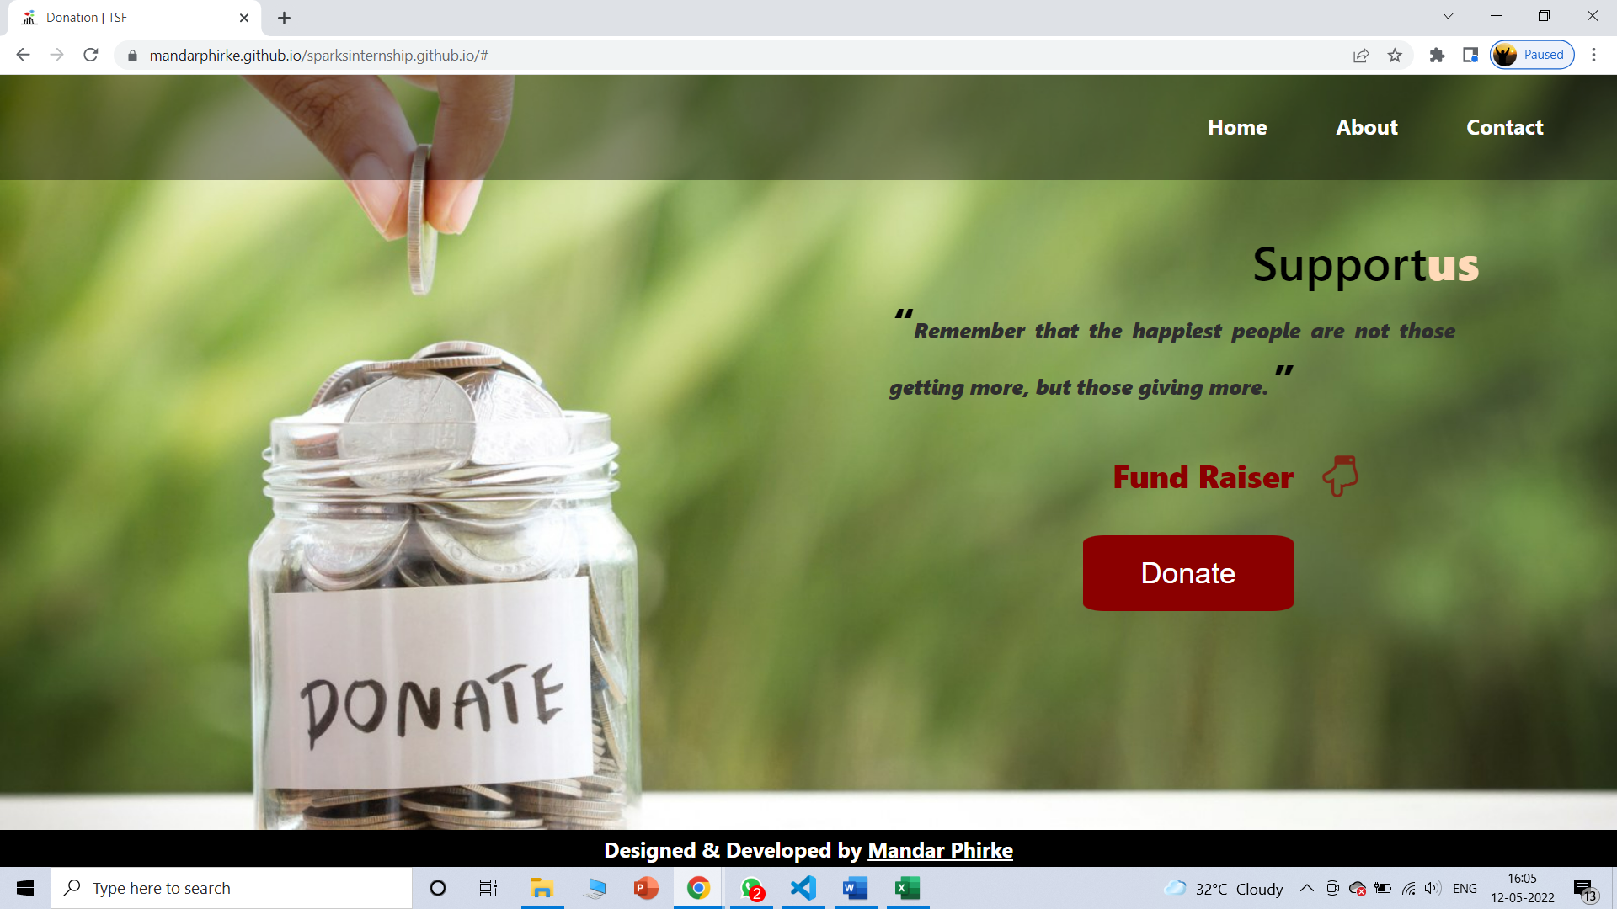
Output:

Slide 11
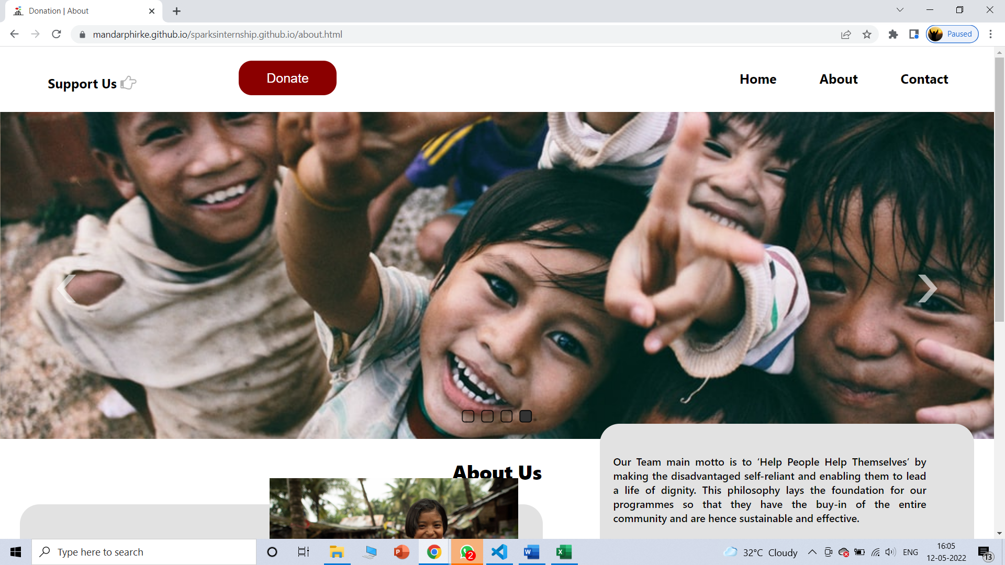

Slide 12
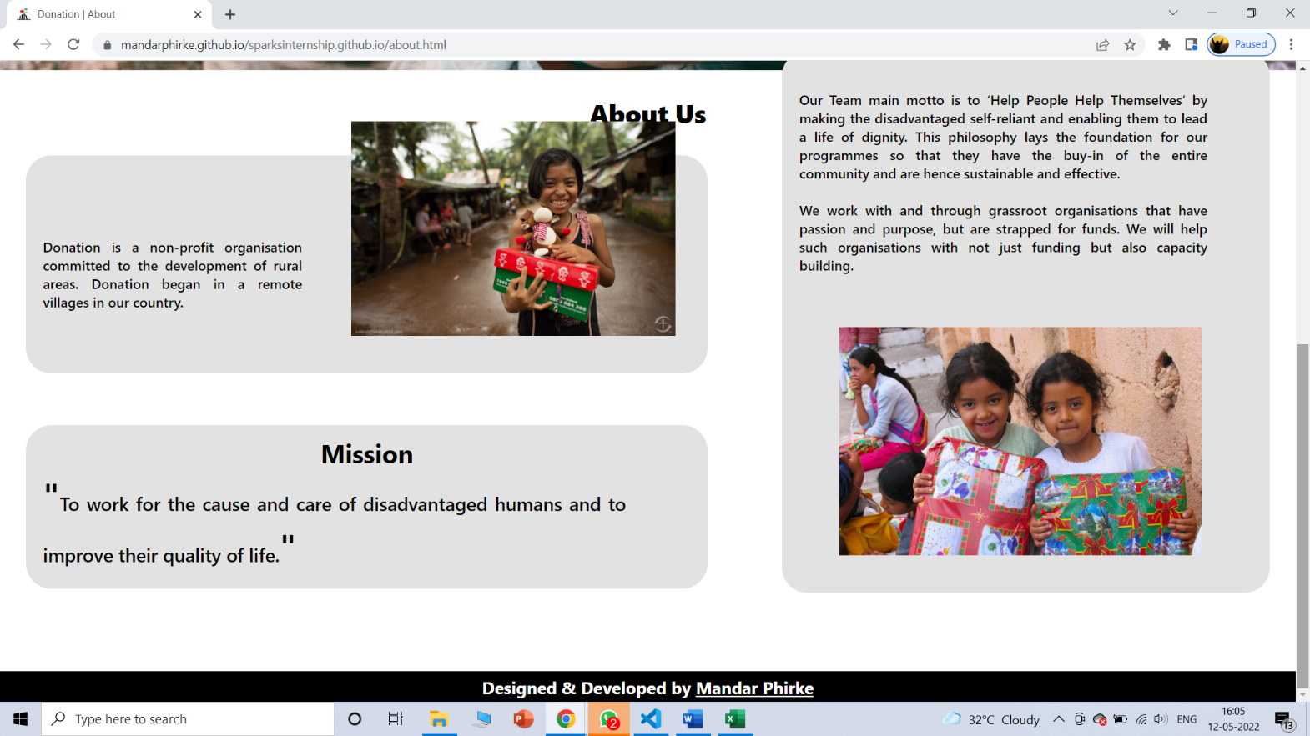

Slide 13
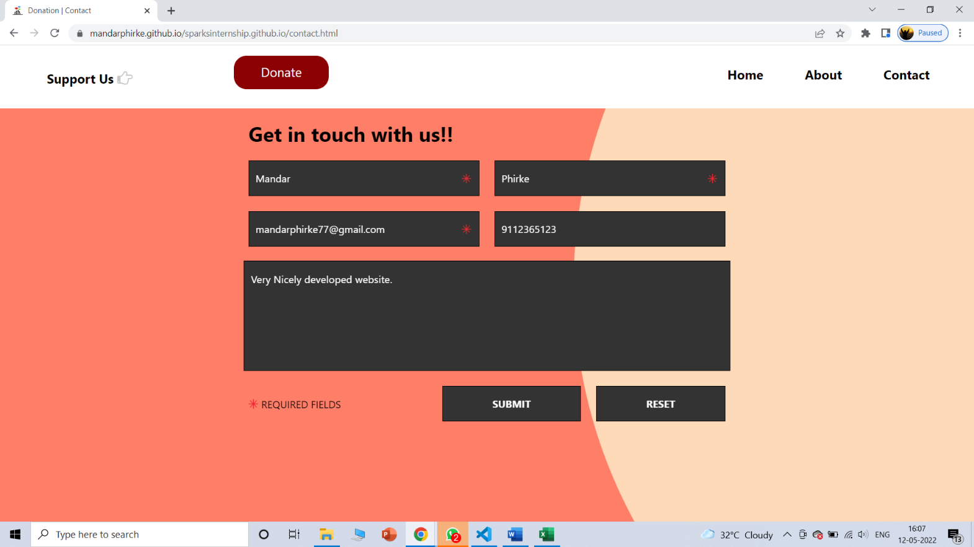

Slide 14
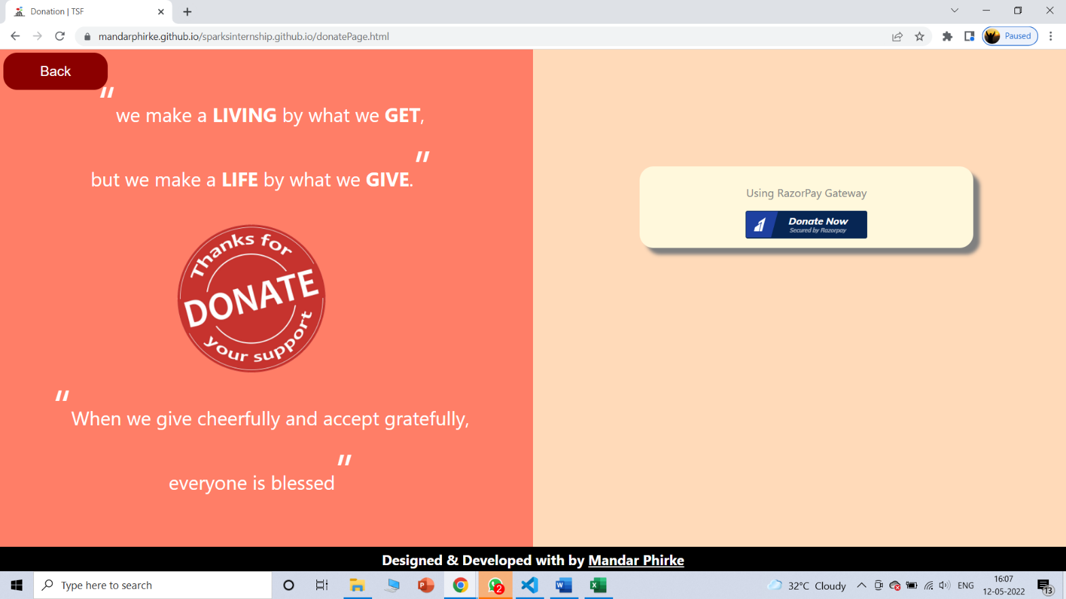

Slide 15
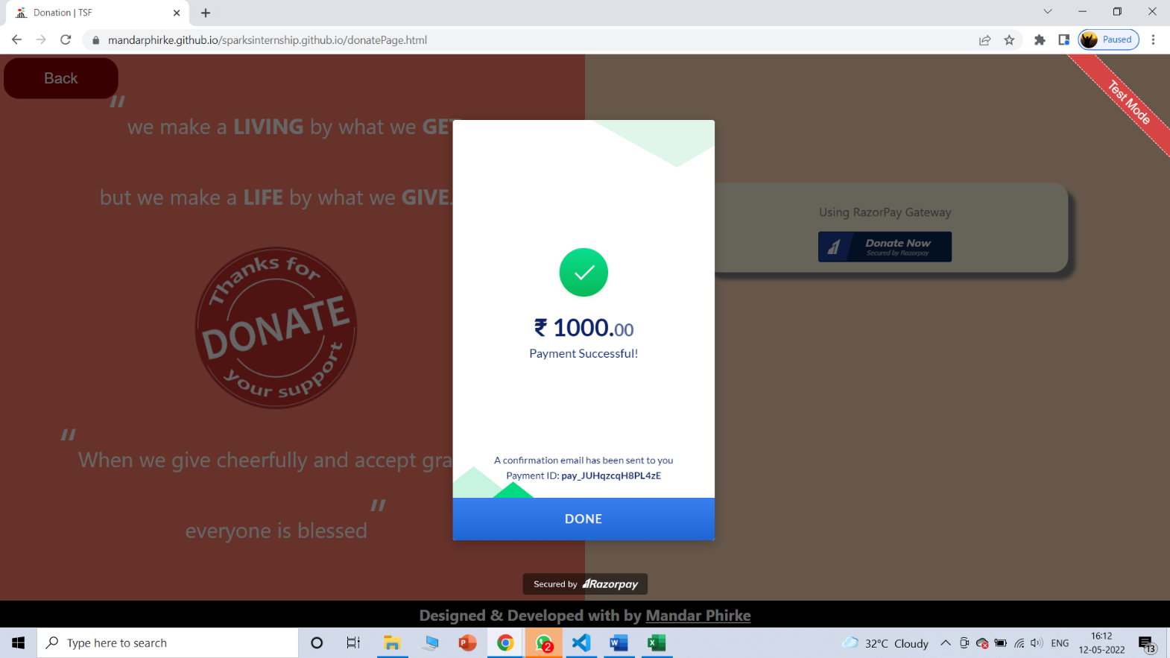

Slide 16
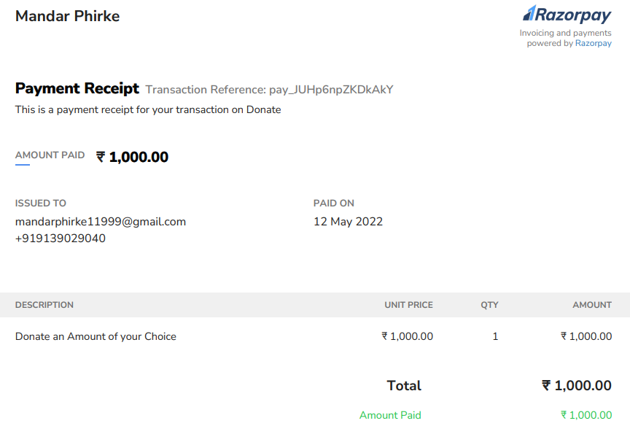

Slide 17
CONCLUSION:-
I can conclude that there has been a lot I've learnt from my work at Sparks foundation. In 1 month, I worked on frontend projects. I was able to learn and work on various new technologies during this time. The skills and knowledge gained in my internship period were used to put into practice in my next projects.
This internship has been an excellent and rewarding experience. I was able to interact and make connections with some other interns of the company. This helped me to grow my network which indirectly beneﬁted me to reach out to more people and gain more industry trends.
My 1-month time in the company was perfect guidance of what learning path to follow. The ﬁnal goal of my overall work was to develop industry-recognized projects which will help me in the future and I can be proud of the period of my internship.

Slide 18
Thank You !
Presentation By:
Name:Mandar Phirke
Class: TE COMP-B
PRN Number : F19112029

